Slide 1


Investing in the Future

Slide 2



Problem statement
Green startups don't have the funding to make their environmental dreams a reality and on the other side, large corporations want to contribute towards sustainable startups but face legal fees and complications that hinder their interest!
>

Slide 3


Solution statement
Investure bridges the gap between green startups looking for funding and big corporations looking to improve their CSR.

Slide 4
Corporations
1% commission
$25,000
Investure
York
University
Startups
Tax write-offs included in CSR initiatives
Rights
$25,000
Government

Slide 5


Data
Analysis
In 2019, global venture capital investment into startups focused on sustainability jumped 143 percent, to $10.7 billion
170,000 green startups in 2014.
56% of startups make it past their 5th year
29% fail because of financial issues

Slide 6

What Makes Us Different?
No other investing platform focuses exclusively on green startups
Is beneficial to both parties by creating awareness
Convenient as it connects two entities that would otherwise never be able to connect effectively on their own.

Slide 7







Traction
Potential market includes 1.7 million C corporations and all green startups
Startup recruitment from startup accelerators, ex. LaunchYU
Social media marketing

Slide 8
Timeline
FEB-MARCH 2020
APRIL 2020
APRIL 2022
IN 2024....
Government grant approval and launch advertising campaign to recruit startups and corporations.
Launch Investure in North America and have 1000 startups and 100 corporations on the site.
Launch an international advertising campaign to recruit foreign startups and corporations.
The number one platform for green investment.

Slide 9
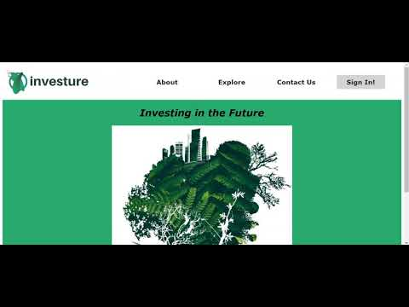
DEMONSTRATION

Slide 10



Our Team
Dhwani
Tanvi
Mansi
UI/UX Designer
Business Analyst
Developer

Slide 11
Questions?

